Slide 1
Using Integration Services to Populate the Maximum Miniatures Manufacturing Data Mart Dimensions
This Tutorial is based on the Learn By Doing Exercise in Chapter 8 of Brian Larson’s Book: Delivering Business Intelligence with Microsoft SQL Server 2012, 3rd edition.

Slide 2
The Purpose of this Tutorial
To extract some dimensional data from a source database (MaxMinAccounting), which is an OLTP database based on a relational data model. You will need to download this MaxMinAccounting database and then restore it using SQL Server Management Studio (see next slide for instructions on where to download the MaxMinAccounting database and how to restore it).
If necessary, to do some transformation by aggregating these extracted data.
To load the extracted data to a destination database (MaxMinManufacturingDM), which is a multidimensional database that you have created early in the first tutorial.

Slide 3
Where to Download MaxMinAccounting Database and How to Restore It Using the SQL Server Management Studio?
You can download the MaxMinAccounting database from this site and then click the Source Code link:
http://www.mhprofessional.com/product.php?isbn=0071759387
Extract the downloaded zip file to a folder that is easily accessible.
Navigate to that folder and open it. Find MaxMinAccountingSystem Database Install subfolder and open it. You should see a file that explain how to install the MaxMinAccounting database as well as a backup file.
Open the instructions file and follow the steps to restore the MaxMinAccounting database backup.

Slide 4
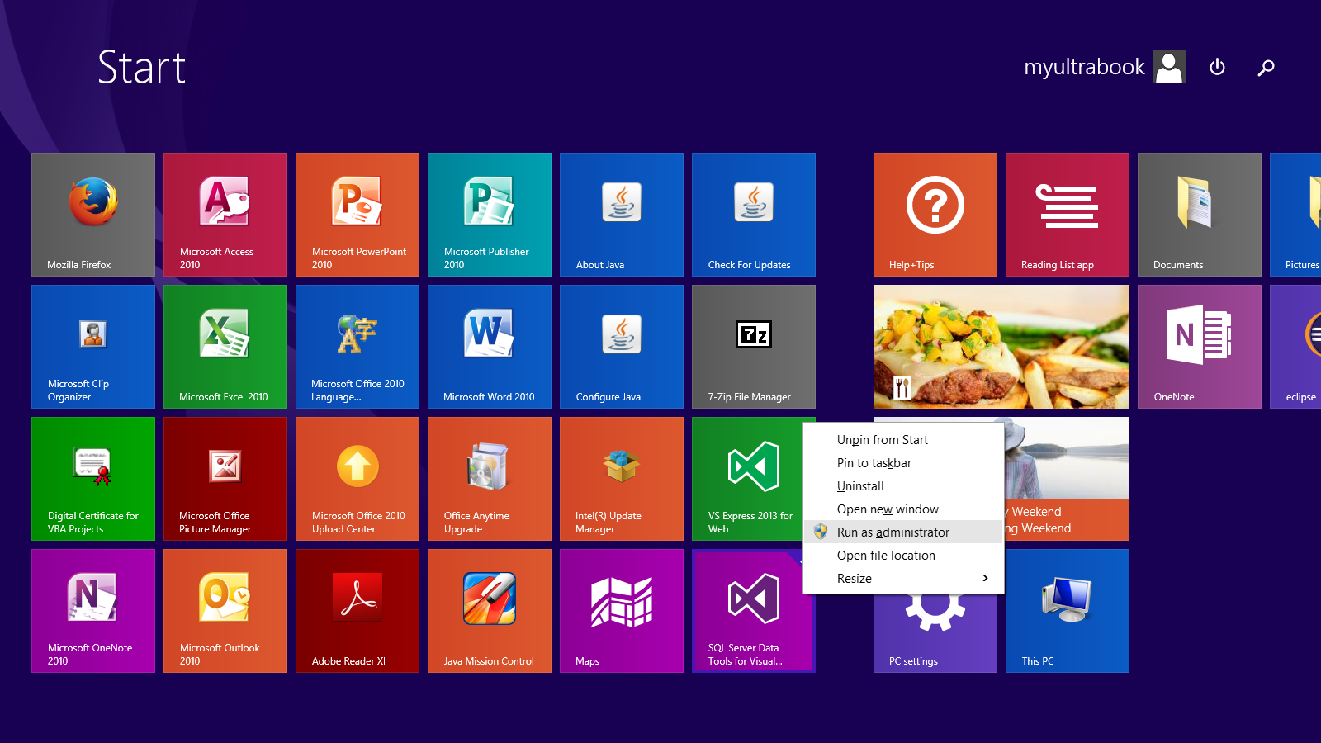
Creating Integration Services Project
1. Right-click the SQL Server Data Tools icon.
2. Select Run as administrator

Slide 5
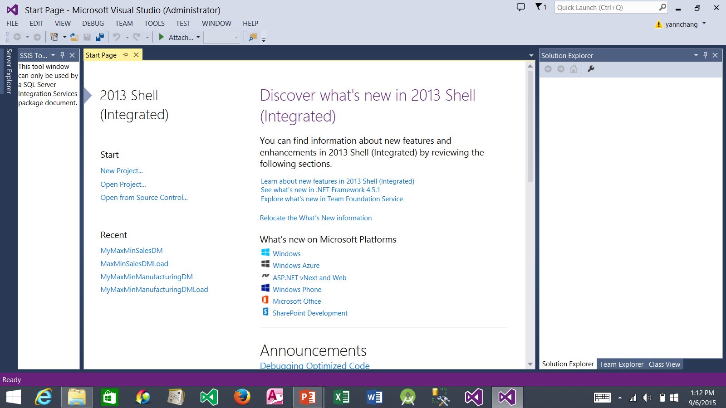
Creating Integration Services Project (continued)
1. Click New Project…

Slide 6
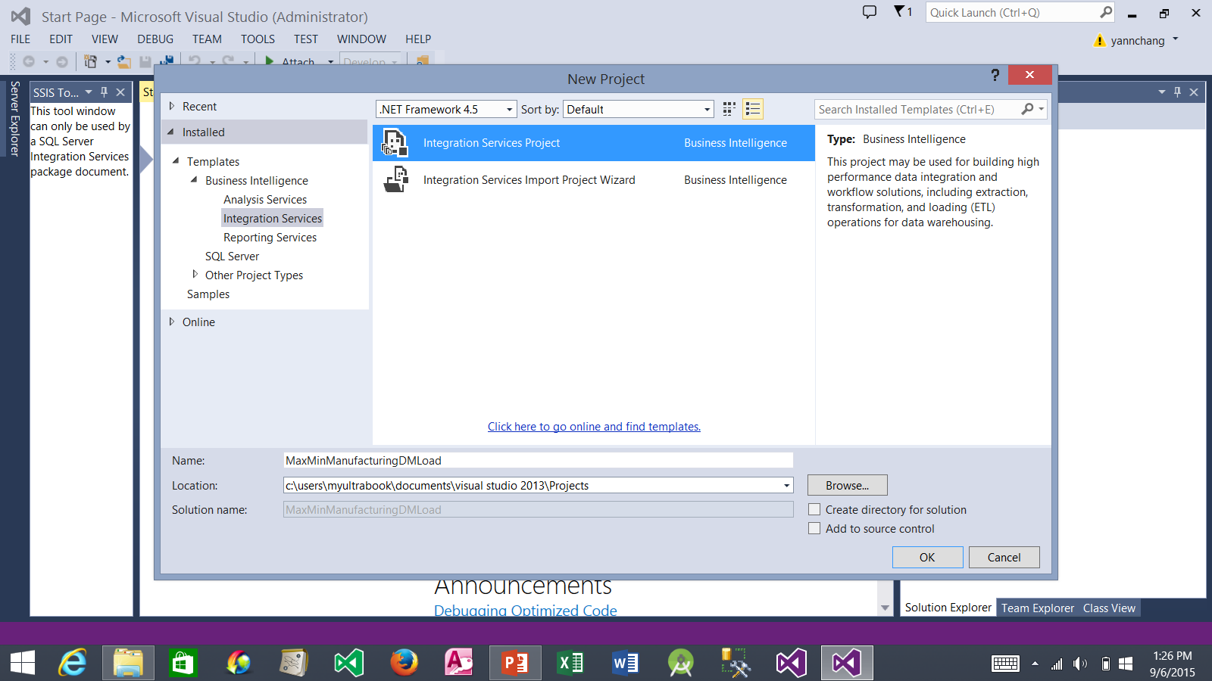
Creating Integration Services Project (continued)
2. Select Integration Services Project
1. Select Integration Services
3. Type the project name
4. Uncheck both options
5. Click the OK button

Slide 7
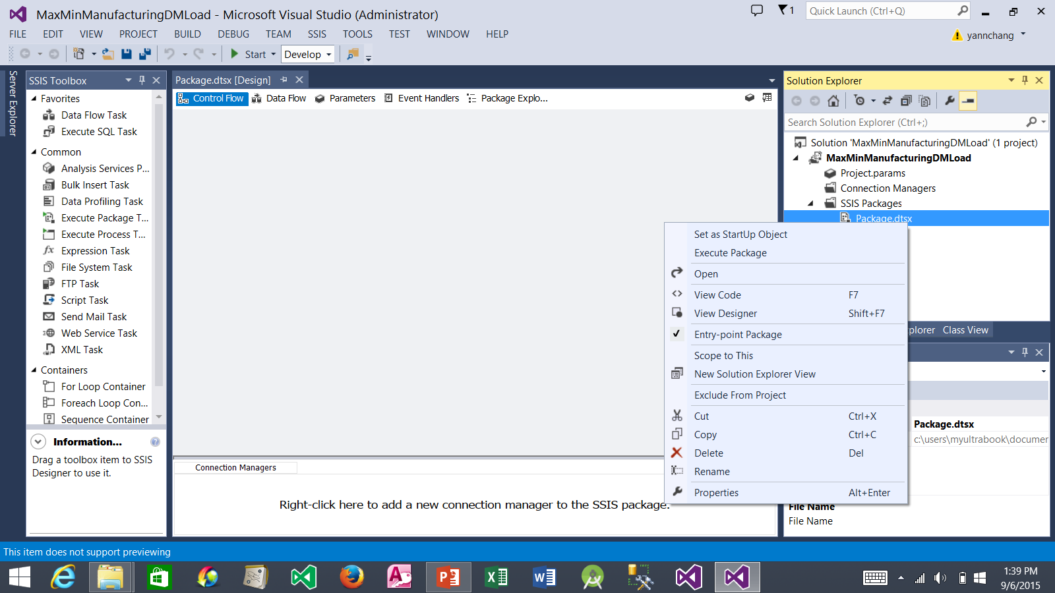
Creating Integration Services Project (continued)
1. Right-click Package.dtsx
3. Rename Package.dtsx to DimensionLoad.dtsx
2. Select Rename

Slide 8
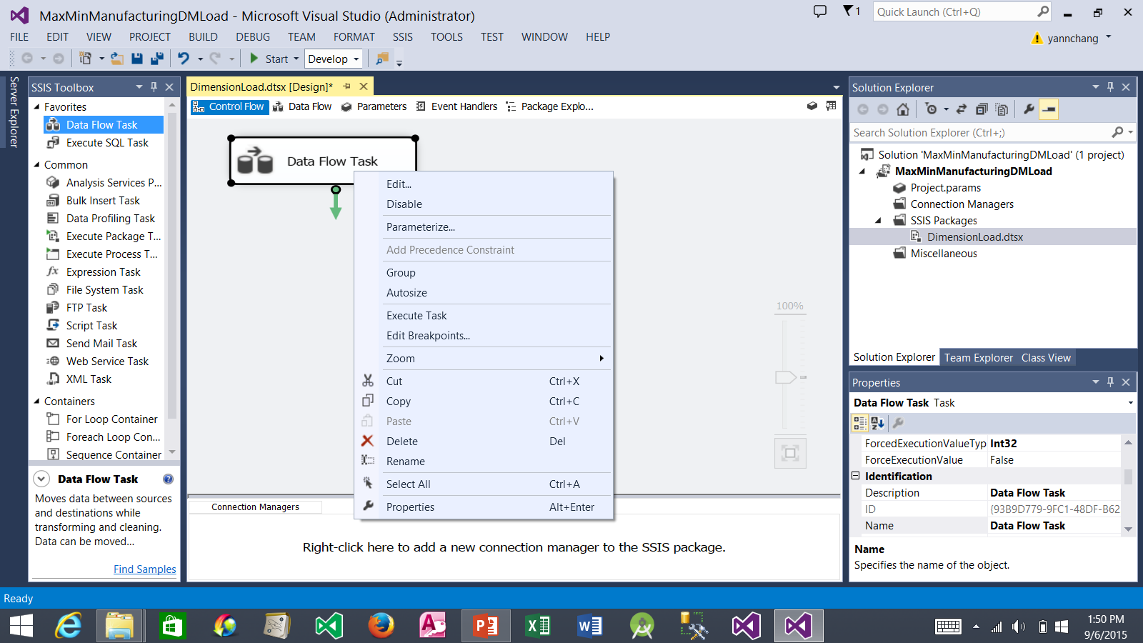
Creating the Data Source for the Load ProductType Data Flow
2. Drop it here and then right-click it
1. Drag the Data Flow Task
3. Select Rename.
4. Rename the Data Flow Task to Load ProductType. Then, double click it. This takes you to the Data Flow tab.

Slide 9
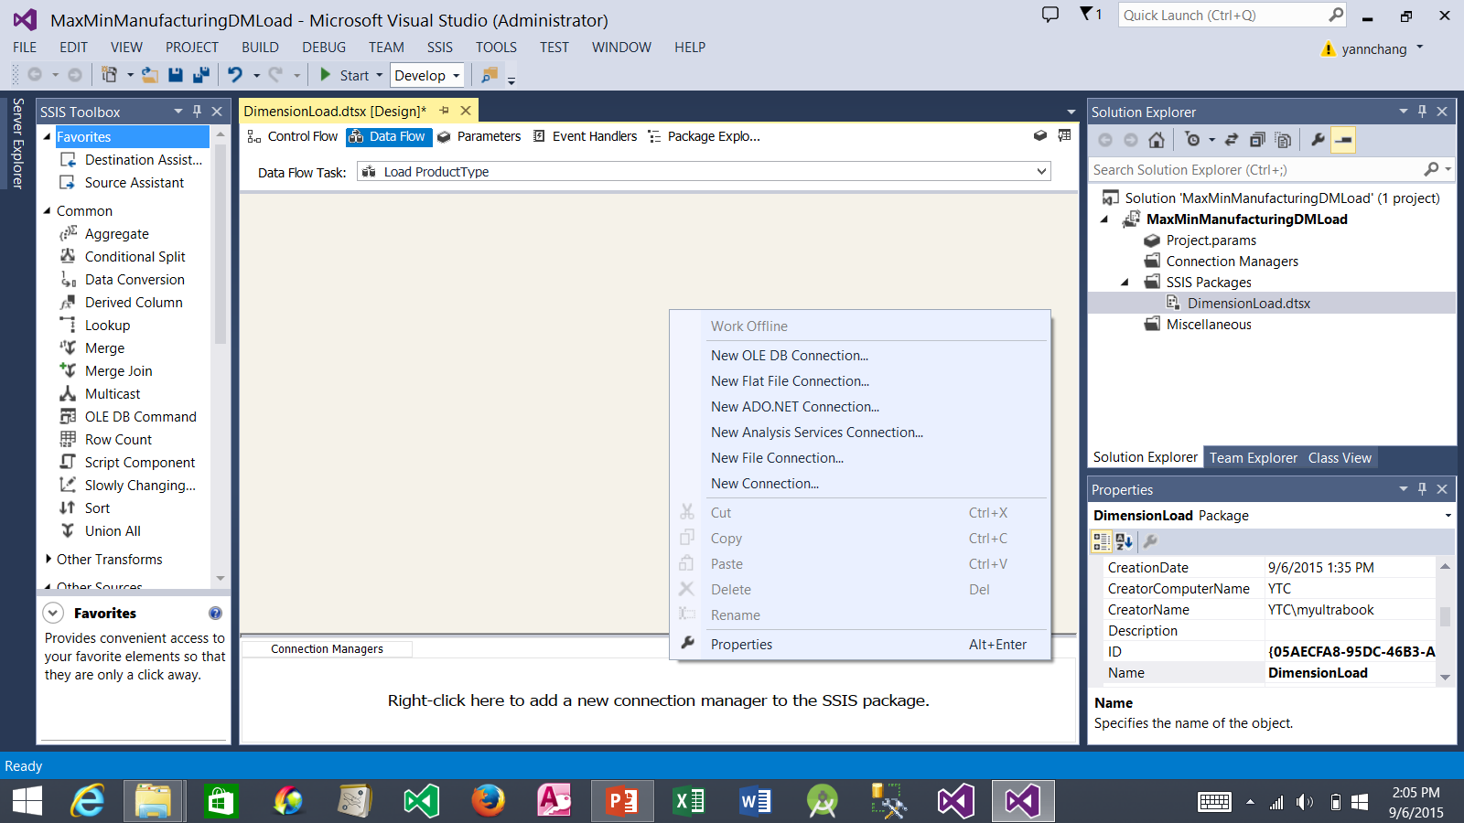
Creating the Data Source for the Load ProductType Data Flow (continued)
2. Select New ADO.NET Connections…
1. Right-click in this area.

Slide 10
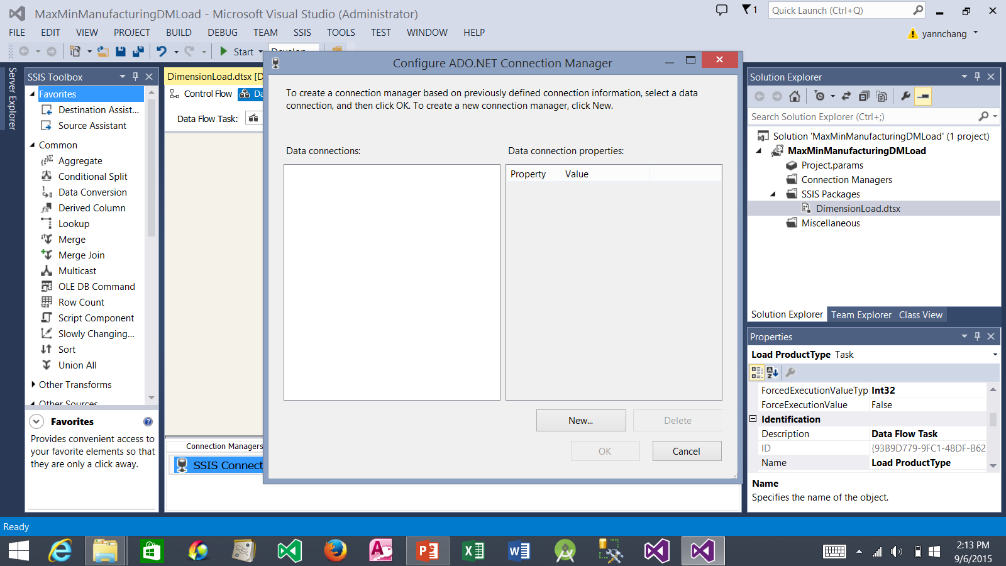
Creating the Data Source for the Load ProductType Data Flow (continued)
1. Click New....

Slide 11
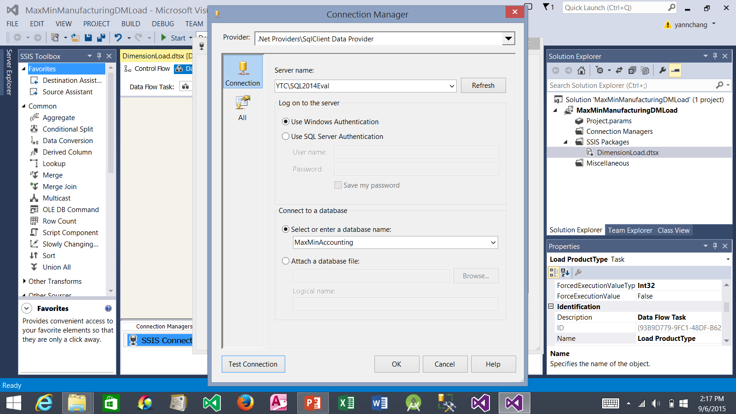
Creating the Data Source for the Load ProductType Data Flow (continued)
1. Enter YourComputerName\SQL Server Instance Name
2. Select MaxMinAccounting database from the drop-down list. If you did not see MaxMinAccounting database in the drop-down list, you did not properly restore it from the backup file.
3. Click the OK button

Slide 12
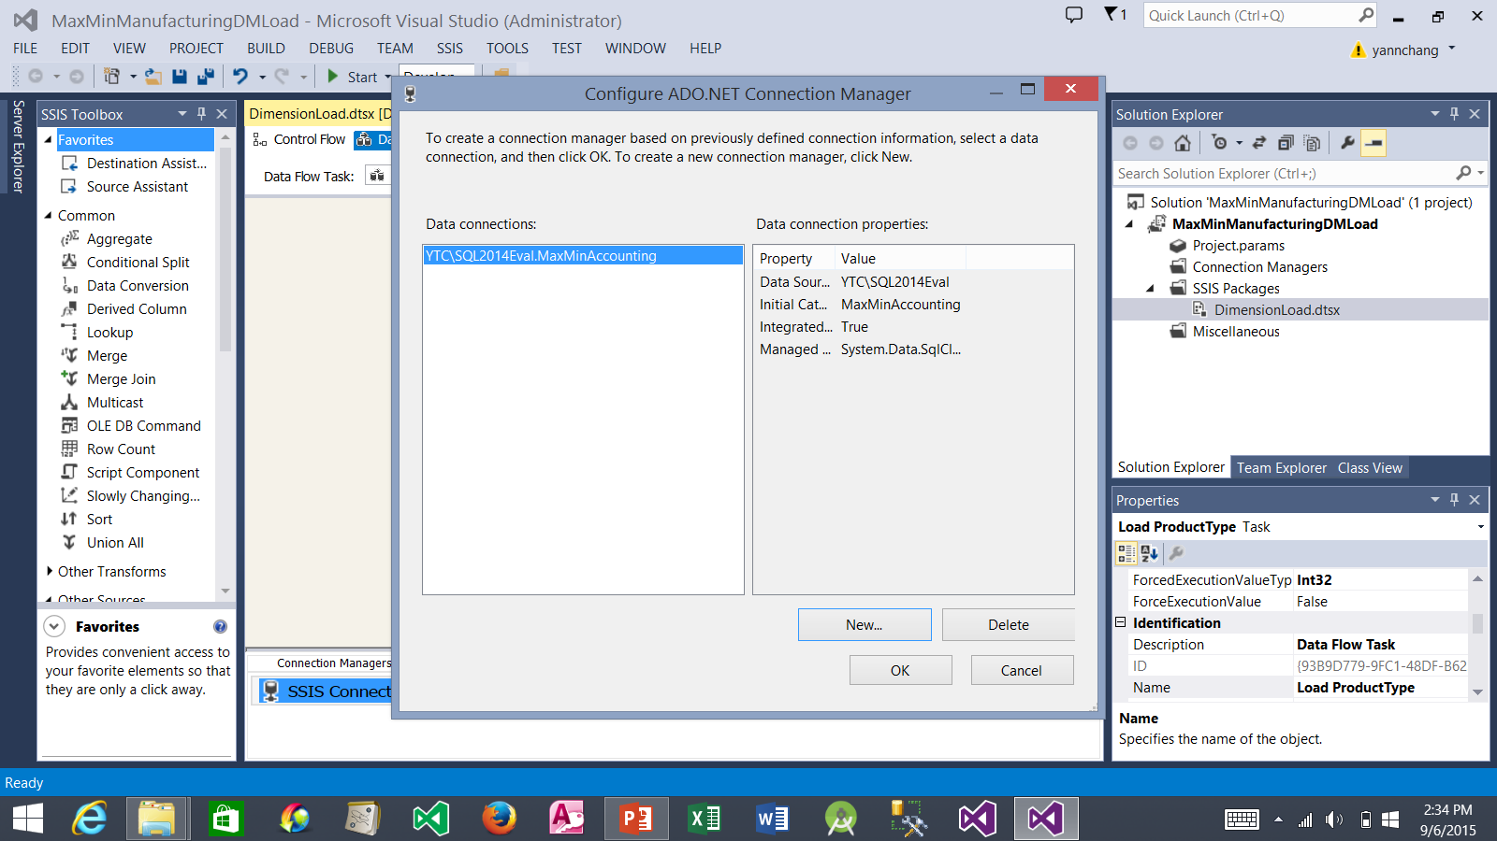
Creating the Data Source for the Load ProductType Data Flow (continued)
1. Click the OK button

Slide 13
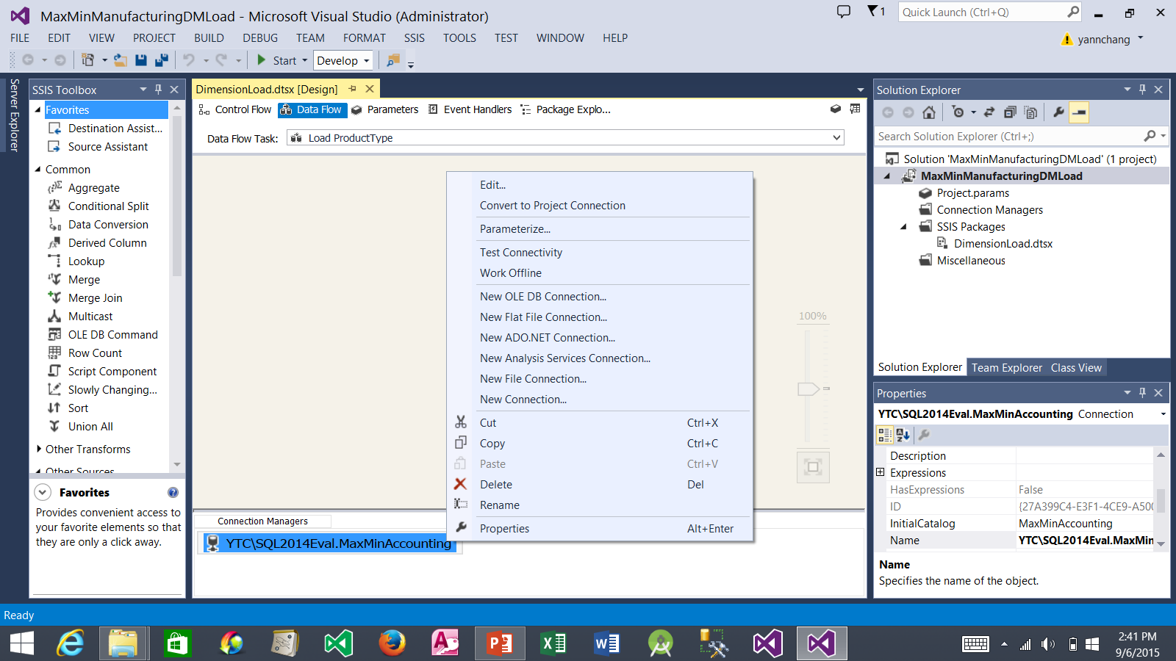
Creating the Data Source for the Load ProductType Data Flow (continued)
1. Right-click the connection name and select Rename. Remove the dot and all characters before it. The new simple name should read: MaxMinAccounting

Slide 14
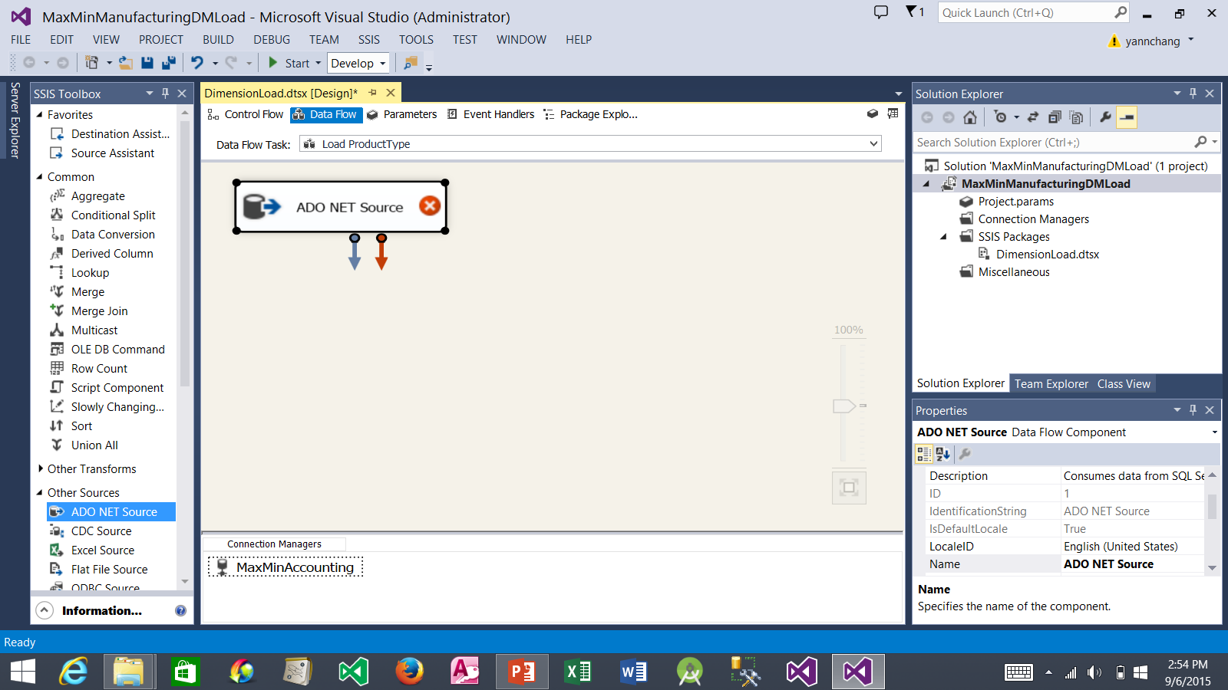
Creating the Data Source for the Load ProductType Data Flow (continued)
2. Drop it here. Then, double click it. The ADO NET Source Editor window should appears.
1. Drag the ADO NET Source

Slide 15
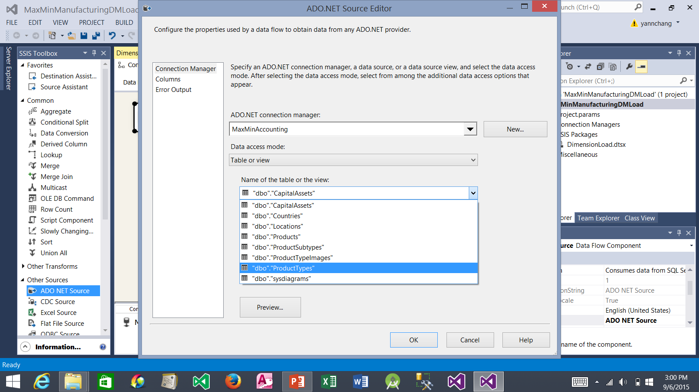
Creating the Data Source for the Load ProductType Data Flow (continued)
1. Select the MaxMinAccounting connection that you just created earlier.
2. Select dbo.ProductTypes
3. Click the OK button

Slide 16
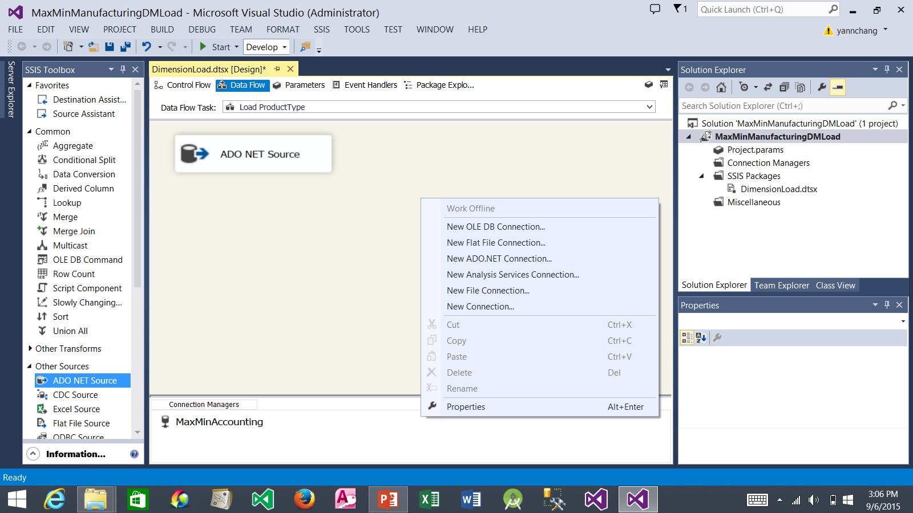
Creating the Data Destination for the Load ProductType Data Flow
2. Select New OLE DB Connection….
1. Right-click in this area.

Slide 17
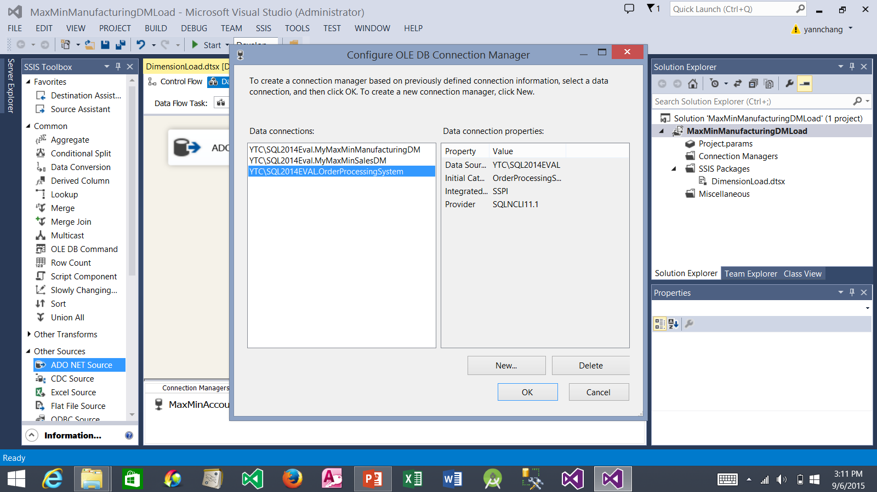
Creating the Data Destination for the Load ProductType Data Flow (cont.)
1. Click New...

Slide 18
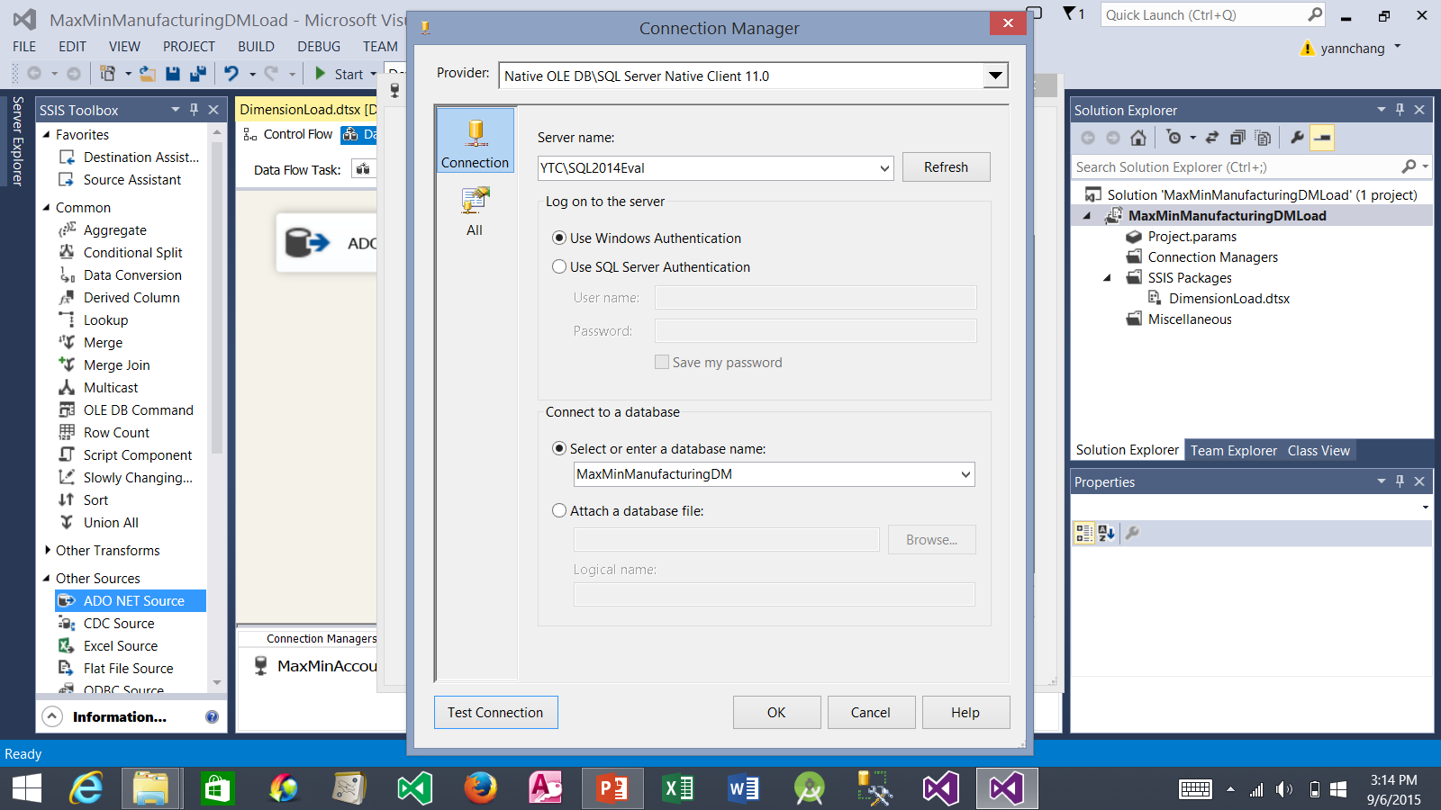
Creating the Data Destination for the Load ProductType Data Flow (cont.)
1. Enter YourComputerName\SQL Server Instance Name
2. Select MaxMinManufacturingDM database from the drop-down list. If you did not see it in the drop-down list, you did not properly create it according to the first tutorial.
3. Click the OK button

Slide 19

Creating the Data Destination for the Load ProductType Data Flow (cont.)
1. A new connection to MaxMinManufacturingDM was created.
2. Click the OK button.

Slide 20
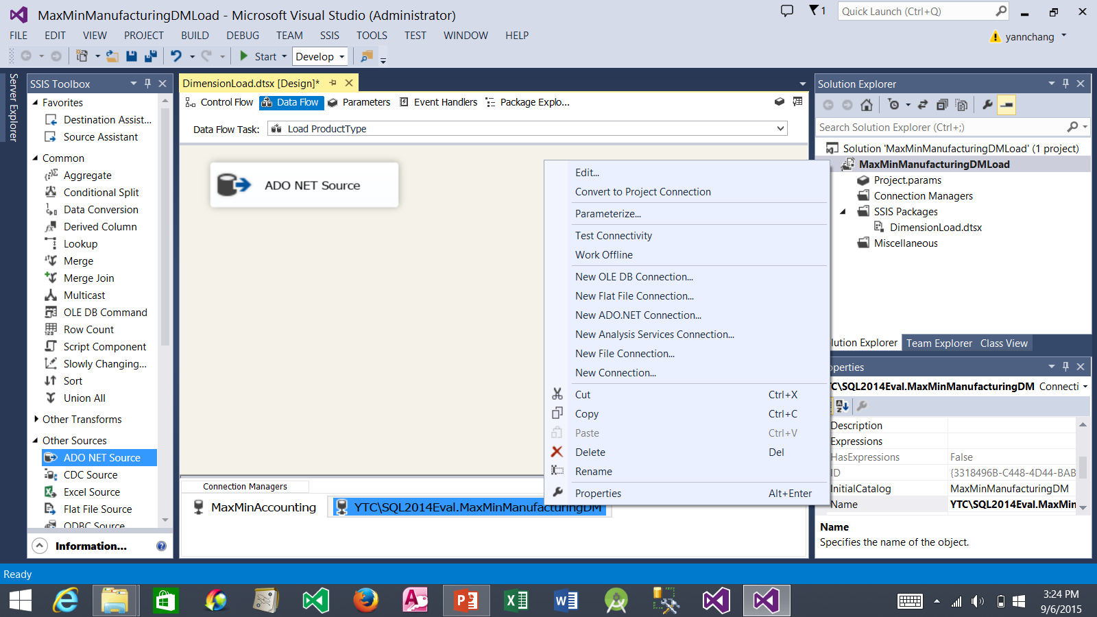
Creating the Data Destination for the Load ProductType Data Flow (cont.)
1. Right-click the connection name and select Rename. Remove the dot and all characters before it. The new simple name should read: MaxMinManufacturingDM

Slide 21
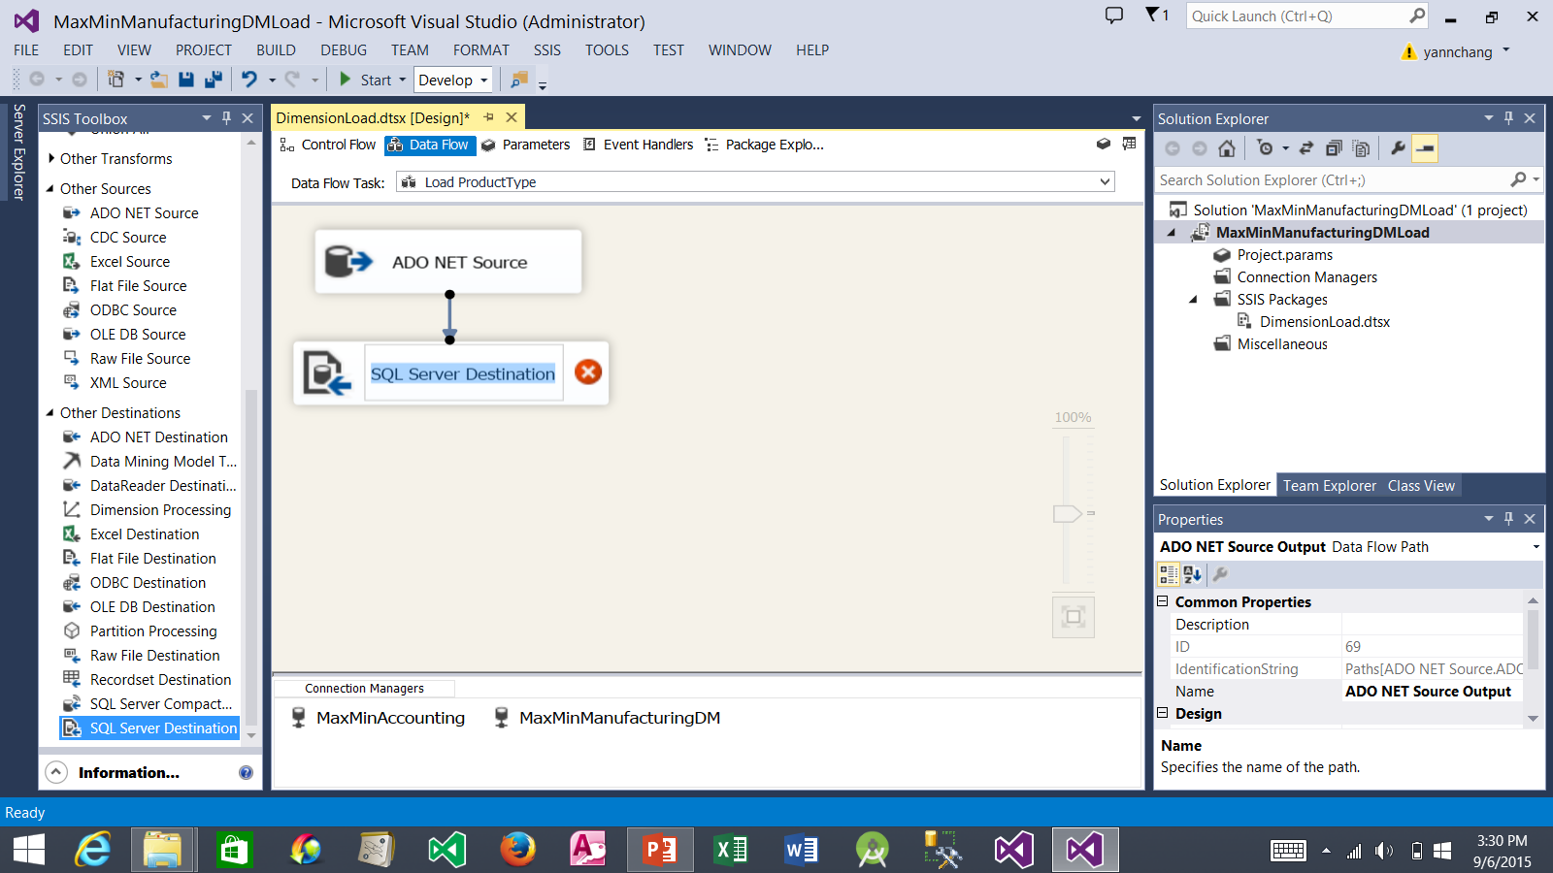
Creating the Data Destination for the Load ProductType Data Flow (cont.)
3. Select ADO NET Source. Drag the blue data flow arrow and drop it on top of SQL Server Destination. This connect the source to the destination.
4. Double click the SQL Server Destination to configure it.
2. Drop it here.
1. Drag SQL Server Destination.

Slide 22
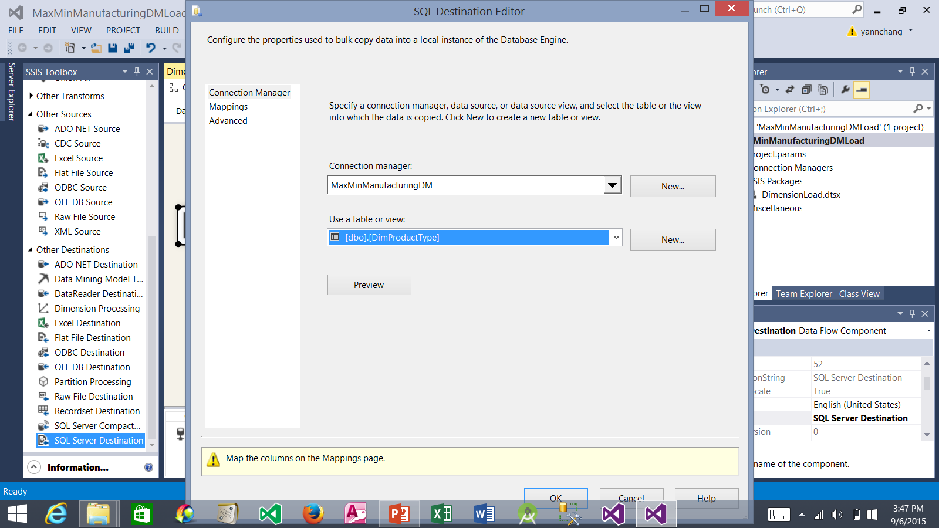
Creating the Data Destination for the Load ProductType Data Flow (cont.)
1. Select the MaxMinManufacturingDM connection that you created earlier.
2. Select dbo.DimProductType.
3. Click Mappings.

Slide 23
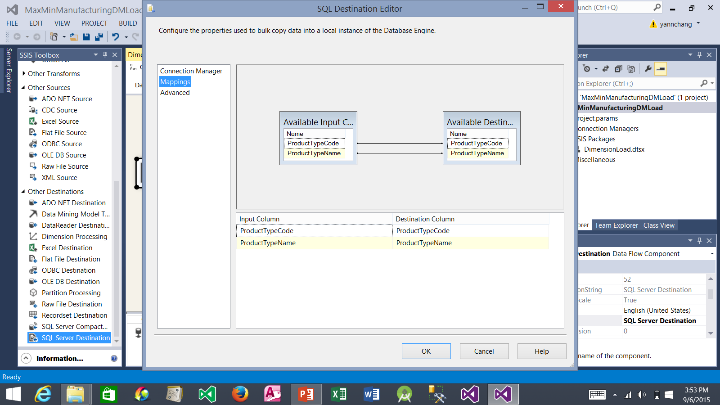
Creating the Data Destination for the Load ProductType Data Flow (cont.)
1. The columns from the source (input) should be automatically mapped to the columns in the destination because the column names match.
2. Click the OK button.

Slide 24
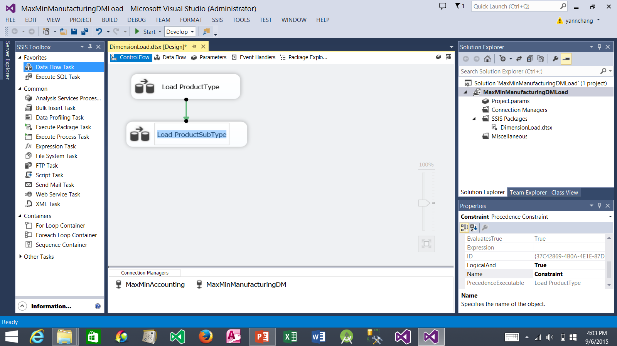
Creating the Load ProductSubType Data Flow
1. Click the Control Flow tab.
4. Click the Load ProductType. Drag the green precedence arrow and drop it on top of the Load ProductSubType. This means that the Load ProductType item must complete successfully before the Load ProductSubType item can execute.
5. Double click to configure it. This takes you to the Data Flow tab.
2. Drag the Data Flow Task.
3. Drop it here. Right-click it and select Rename. Rename the Data Flow Task to Load ProductSubType.

Slide 25
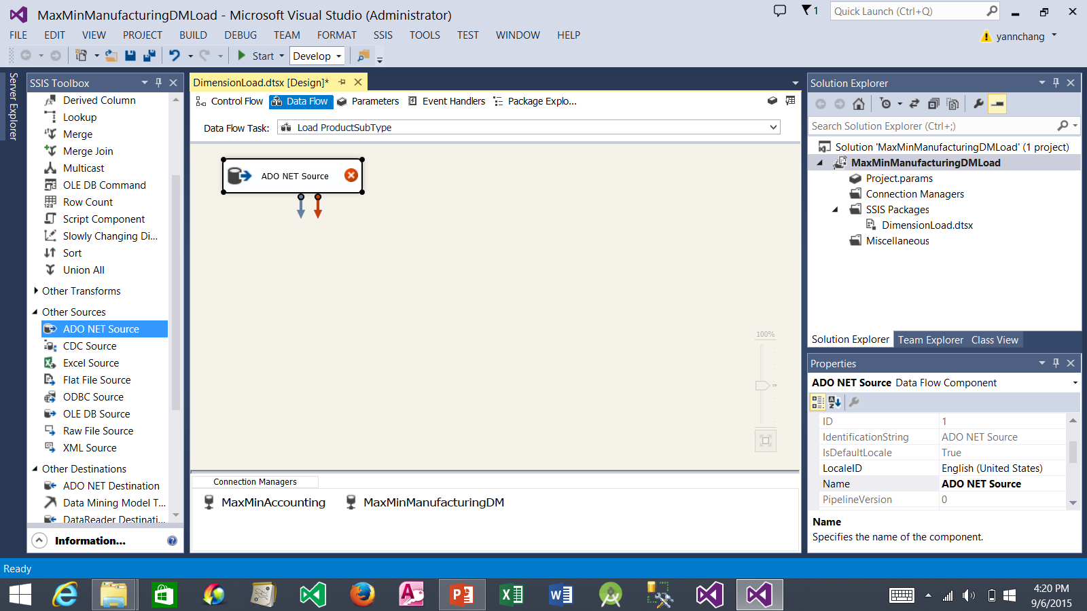
Creating the Load ProductSubType Data Flow (continued)
2. Drop it here. Double click to configure it. The ADO.NET Source Editor window appears.
1. Drag the ADO NET Source.

Slide 26
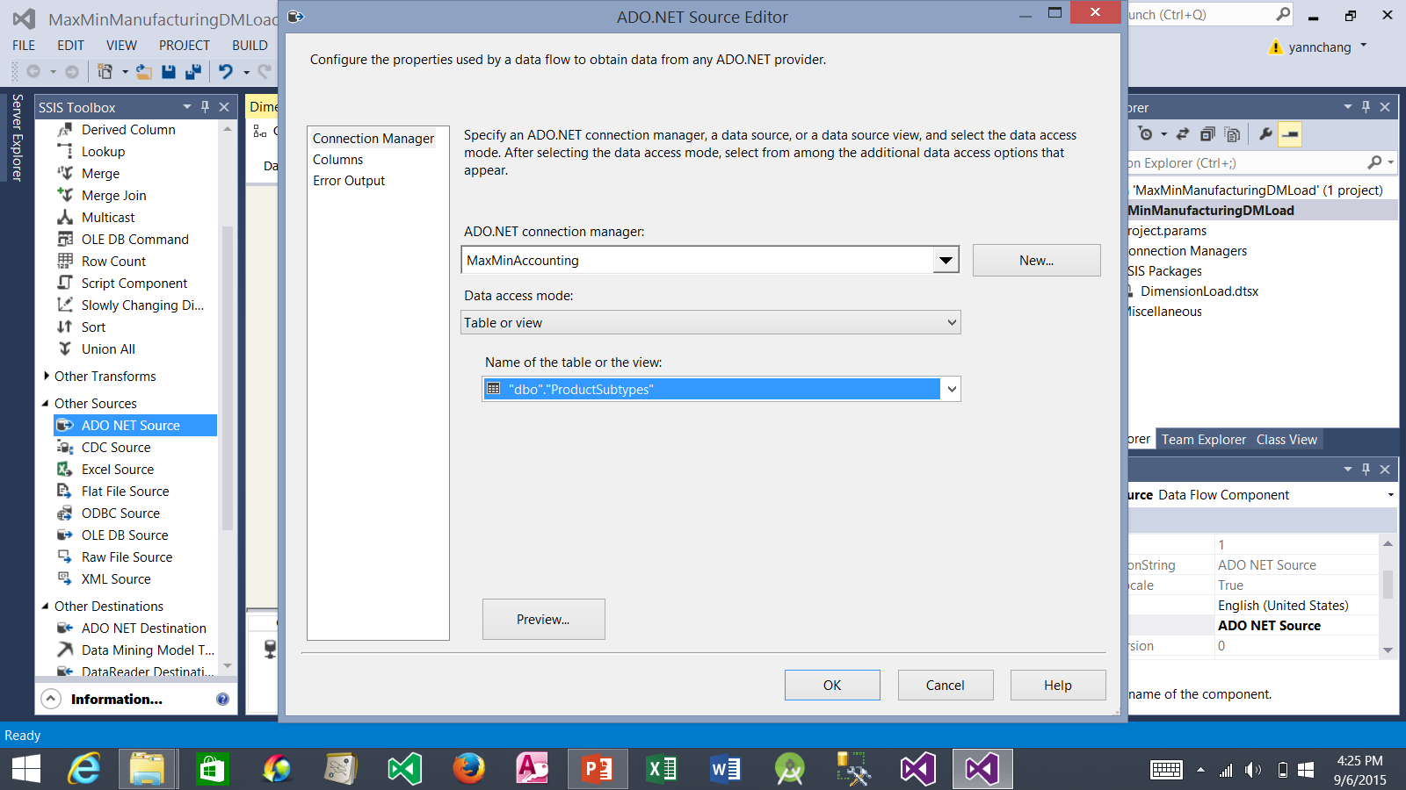
Creating the Load ProductSubType Data Flow (continued)
1. Select MaxMinAccounting.
2. Select dbo.ProductSubType.
3. Click the OK button.

Slide 27
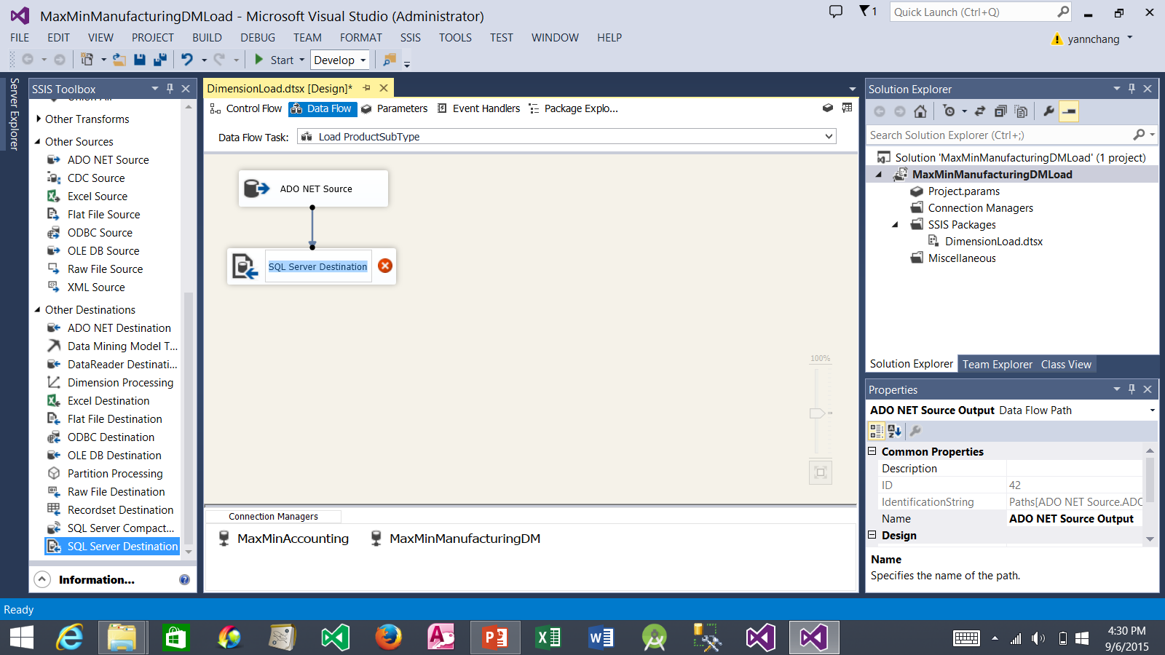
Creating the Load ProductSubType Data Flow (continued)
3. Click the ADO NET Source. Drag the blue data flow arrow and drop it on top of the SQL Server Destination. This connect the two items.
4. Double click the SQL Server Destination to configure it. The SQL Destination Editor appears.
2. Drop it here.
1. Drag the SQL Server Destination.

Slide 28
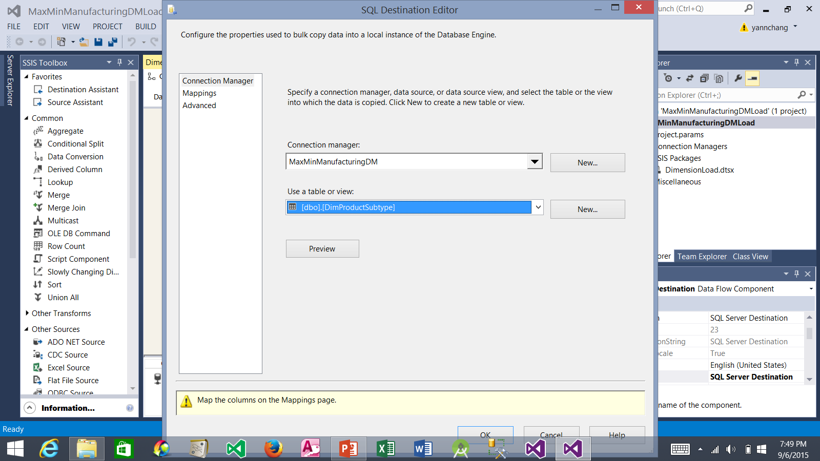
Creating the Load ProductSubType Data Flow (continued)
1. Select MaxMinManufacturingDM.
2. Select dbo.DimProductSubType.
3. Click Mappings.

Slide 29
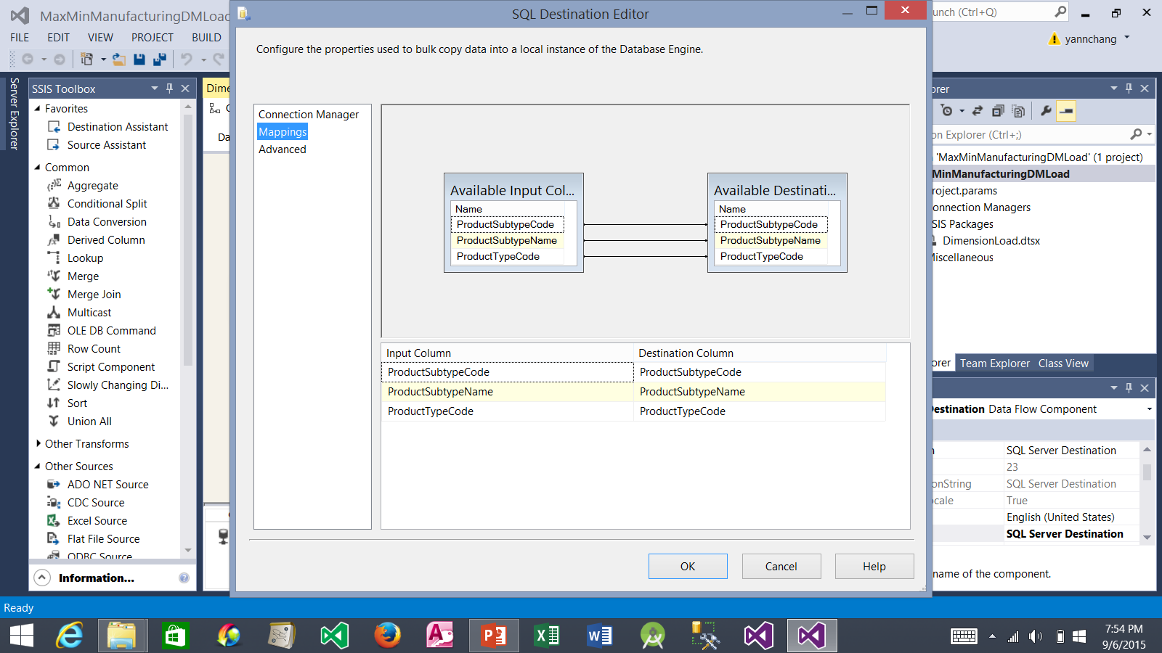
Creating the Load ProductSubType Data Flow (continued)
1. Source (input) columns are automatically mapped to destination columns because the column names are the same.
2. Click the OK button.

Slide 30
Creating Additional Data Flow
Repeat the steps (see Slides 24-29) of Creating the Load ProductSubType Data Flow to get data from MaxMinAccounting.Products table and copy it to the MaxMinManufacturingDM.DimProduct table. Create the precedence arrow to connect the Load ProductSubType and Load Product data flow tasks. Note: the RawMaterial and AmountOfRawMaterial columns are not mapped.
Similarly, repeat the steps (see Slides 24-29) of Creating the Load ProductSubType Data Flow to get data from MaxMinAccounting.Countries table and copy it to the MaxMinManufacturingDM.DimCountry table. Create the precedence arrow to connect the Load Product and Load Country data flow tasks.
Next slide shows the Control Flow tab after completing the above two tasks.

Slide 31
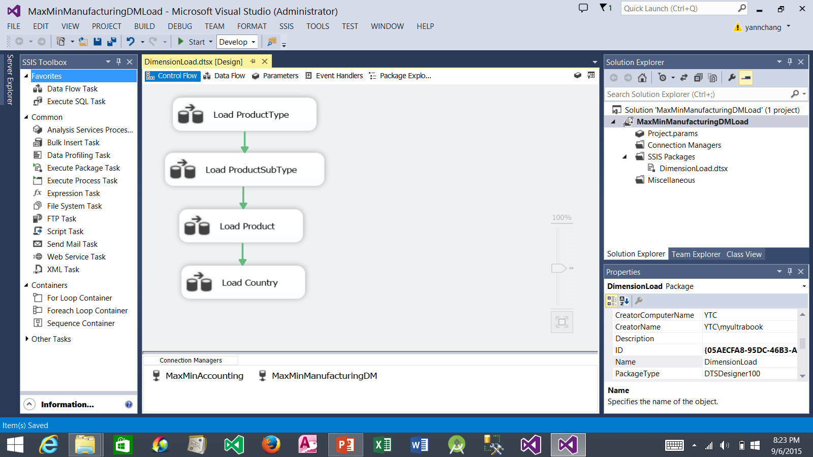
Creating Additional Data Flow (continued)
Be sure to configure Load Product task by double clicking it and then adding and configuring ADO NET Source and SQL Server Destination.
Be sure to configure Load Country task by double clicking it and then adding and configuring ADO NET Source and SQL Server Destination.

Slide 32
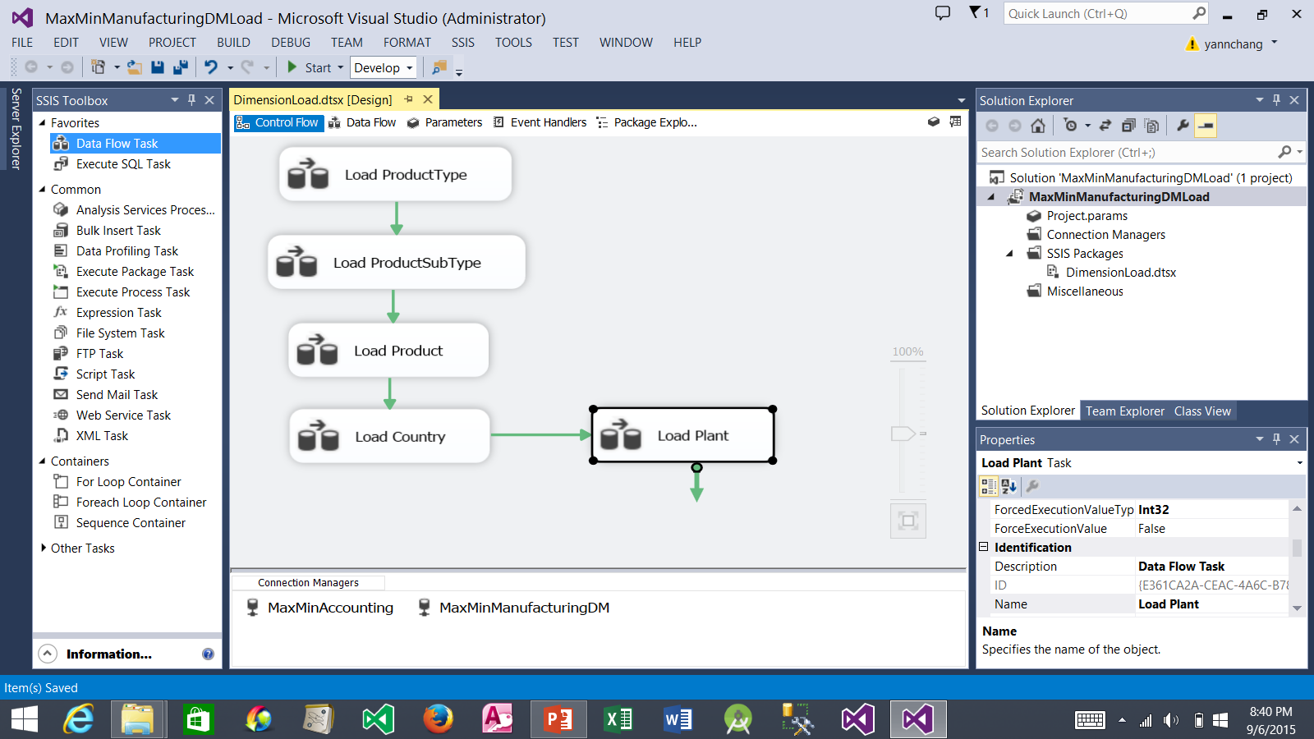
Creating the Load Plant Data Flow
1. Click the Control Flow tab
4. Double click Load Plant to configure it. This takes you to the Data Flow tab.
2. Drag the Data Flow Task.
3. Drop it here. Rename it to Load Plant. Drag the green arrow from Load Country and drop the arrow on top of Load Plant.

Slide 33
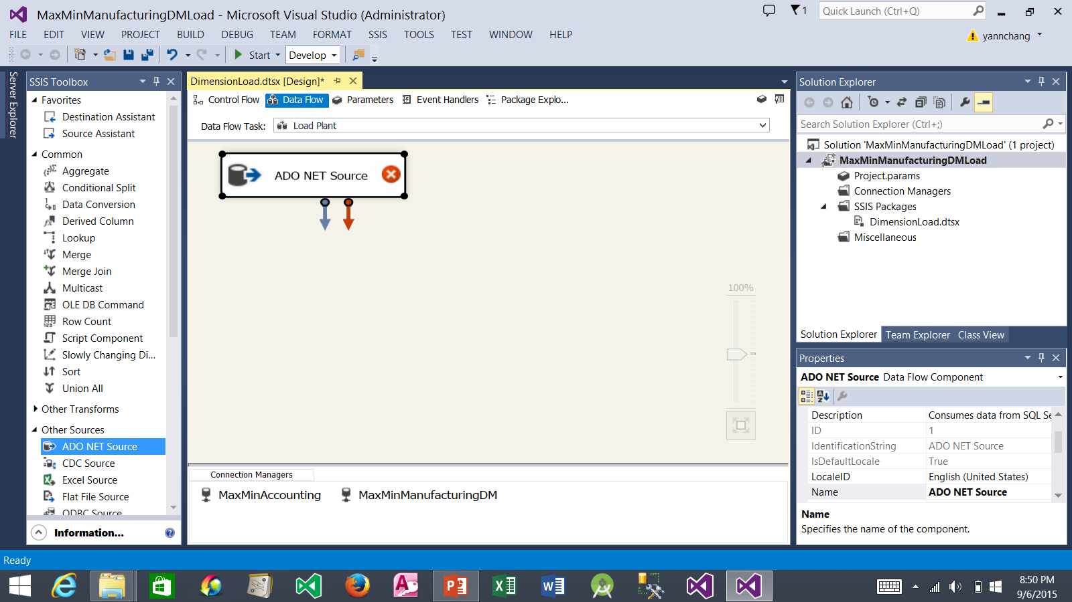
Creating the Load Plant Data Flow (continued)
2. Drop it here. Double click it to configure it.
1. Drag the ADO NET Source.

Slide 34
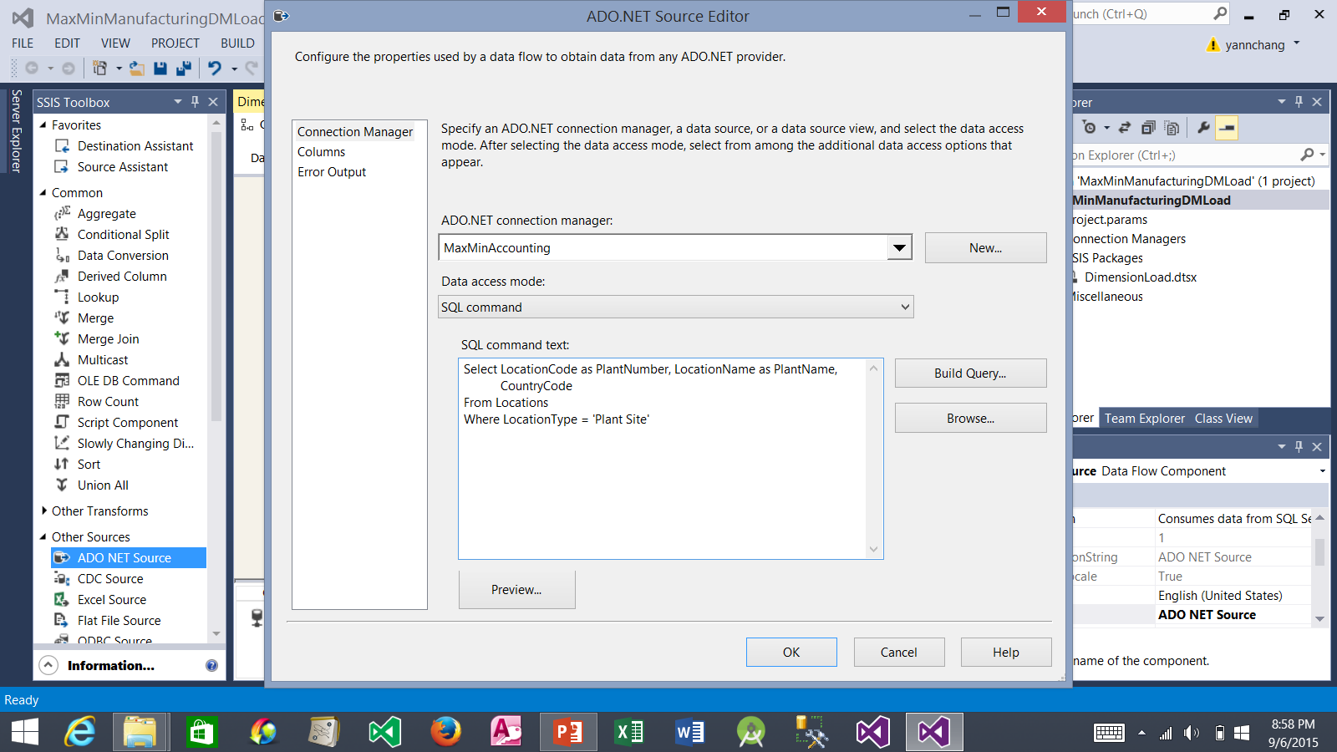
Creating the Load Plant Data Flow (continued)
1. Select MaxMinAccounting.
2. Select SQL command.
3. Type this customized query.
4. Click the OK button.

Slide 35

Creating the Load Plant Data Flow (continued)
2. Drop it here. Drag the blue arrow from ADO NET Source and drop the arrow on top of the SQL Server Destination. Double click SQL Server Destination to configure it.
1. Drag the SQL Server Destination.

Slide 36

Creating the Load Plant Data Flow (continued)
1. Select MaxMinManufacturingDM.
1. Select dbo.DimPlant
3. Click Mappings.

Slide 37

Creating the Load Plant Data Flow (continued)
1. Source (input) columns are automatically mapped to destination columns because the column names are the same.
2. Click the OK button.

Slide 38
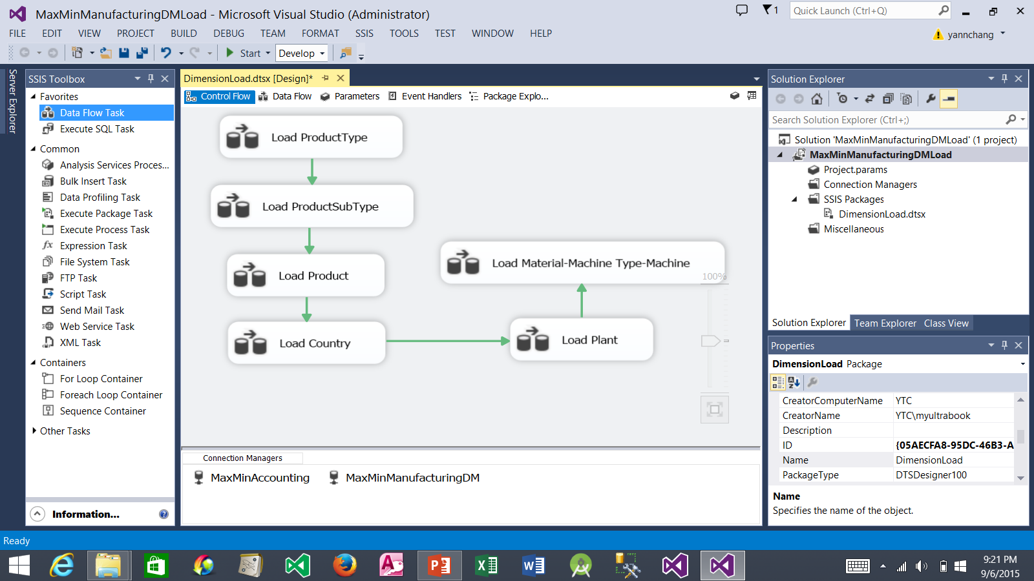
Creating the Load Material-Machine Type-Machine Data Flow
1. Click the Control Flow tab
3. Drop it here. Rename it to Load Material-Machine Type-Machine. Drag the green arrow from Load Plant and drop the arrow on top of Load Material-Machine Type Machine.
2. Drag the Data Flow Task.
4. Double click this to configure it. This takes you to the Data Flow tab.

Slide 39
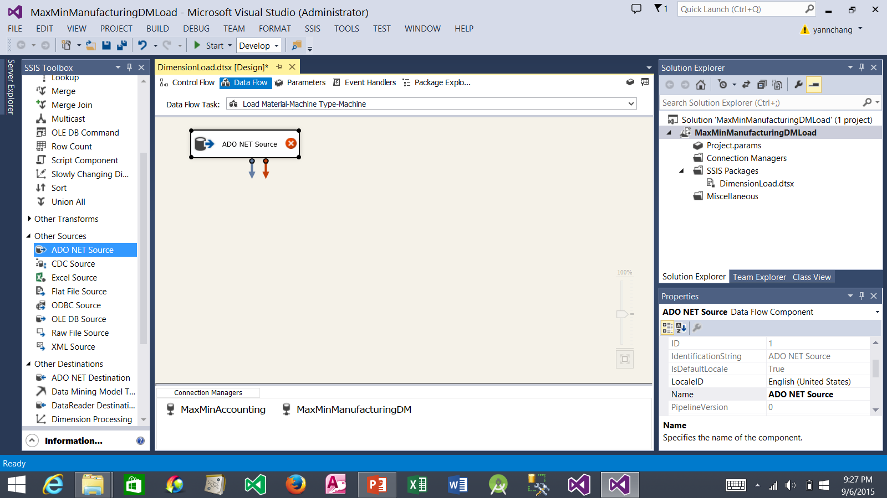
Creating the Load Material-Machine Type-Machine Data Flow (continued)
2. Drop it here. Double click it to configure it.
1. Drag the ADO NET Source.

Slide 40
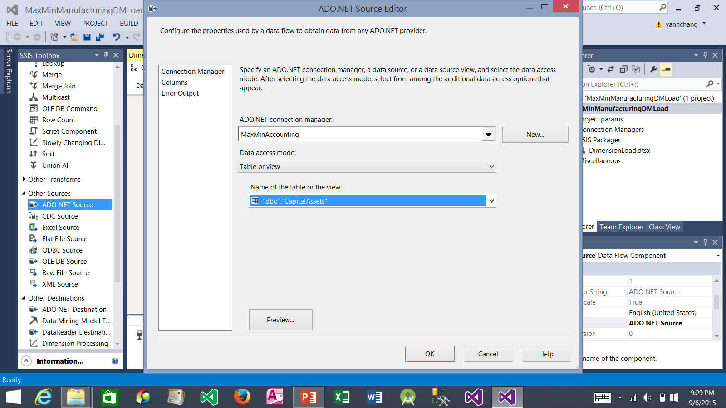
Creating the Load Material-Machine Type-Machine Data Flow (continued)
1. Select MaxMinAccounting.
2. Select dbo.CapitalAssets.
3. Click the OK button.

Slide 41
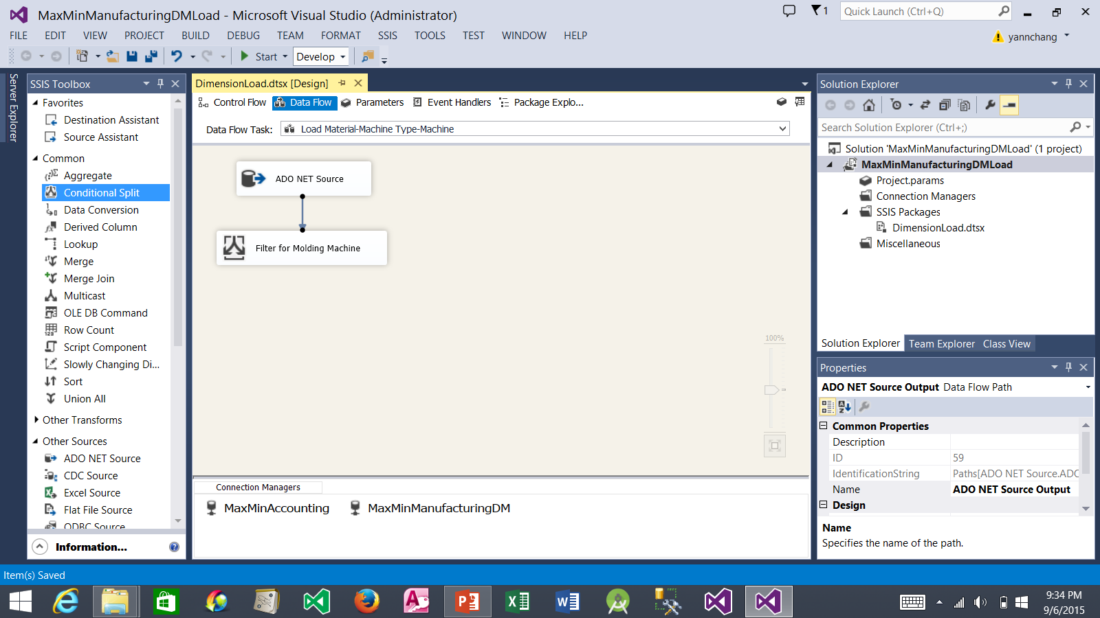
Creating the Load Material-Machine Type-Machine Data Flow (continued)
2. Drop it here. Rename it to Filter for Molding Machine. Drag the blue arrow from ADO NET Source and drop the arrow on top of the Filter. Double click the Filter to configure it.
1. Drag the Conditional Split.

Slide 42
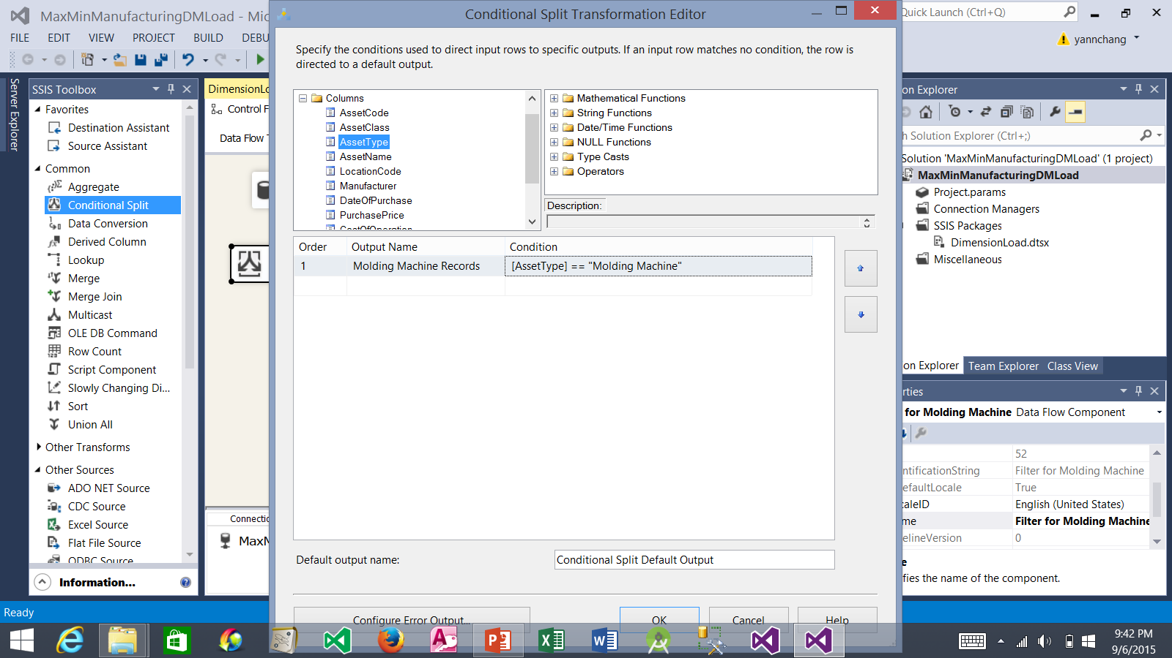
Creating the Load Material-Machine Type-Machine Data Flow (continued)
2. Expand Columns
3. Drag AssetType
4. Drop it here. Complete the expression as shown.
1. Type here: Molding Machine Records
5. Click the OK button

Slide 43
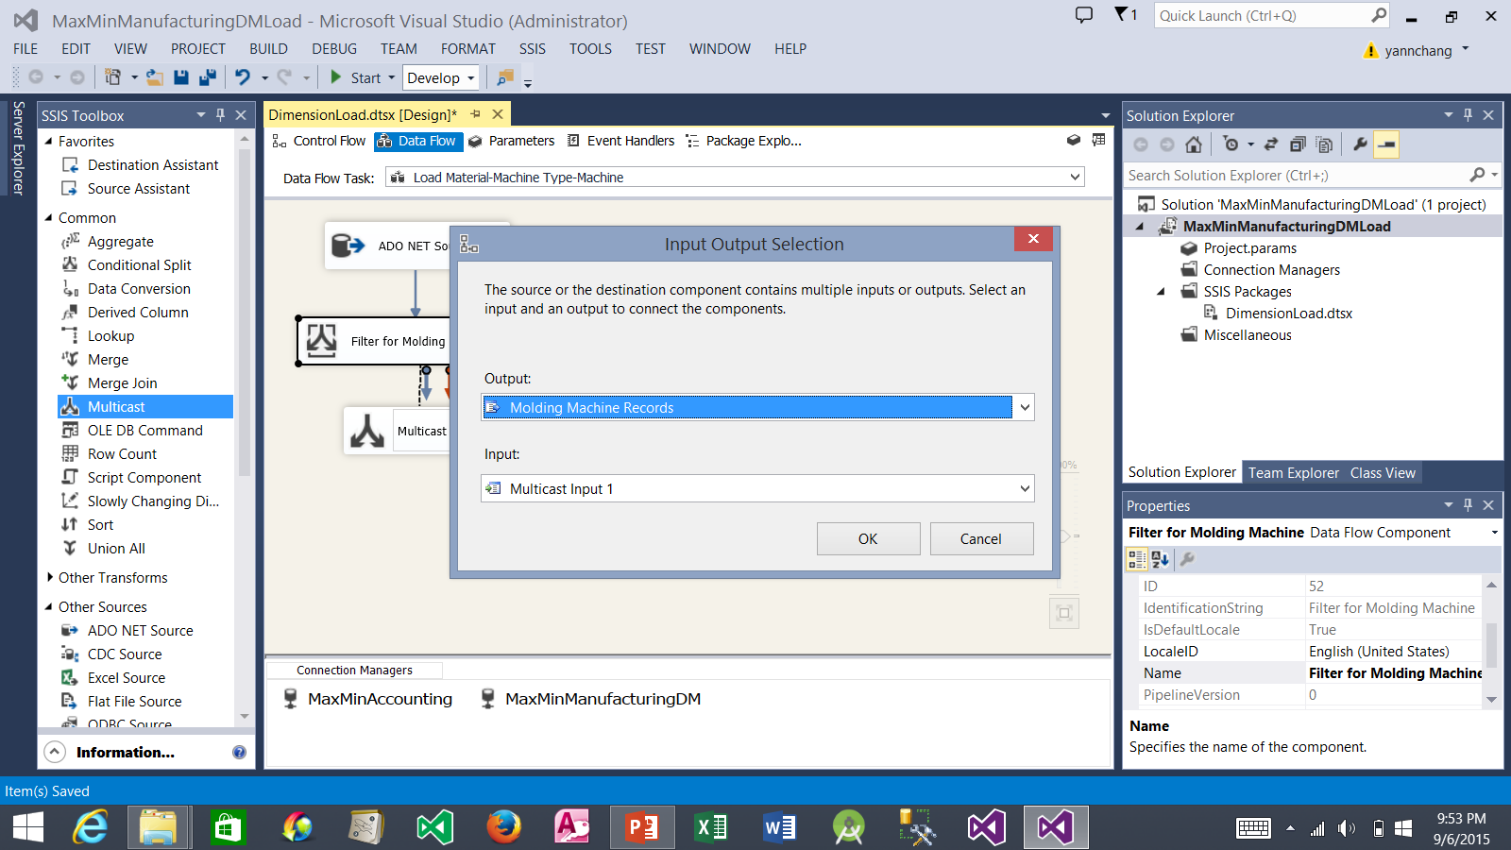
Creating the Load Material-Machine Type-Machine Data Flow (continued)
3. Input Output Selection window appears.
4. Select Molding Machine Records.
1. Drag the Multicast.
2. Drop it here. Drag the blue arrow from Filter for Molding Machine and drop the arrow on the Multicast
5. Click the OK button.

Slide 44

Creating the Load Material-Machine Type-Machine Data Flow (continued)
3. Double click Aggregate By Material to configure it.
1. Drag the Aggregate.
2. Drop it here. Rename it as shown. Drag the blue arrow from Multicast and drop the arrow on the Aggregate By Material.

Slide 45
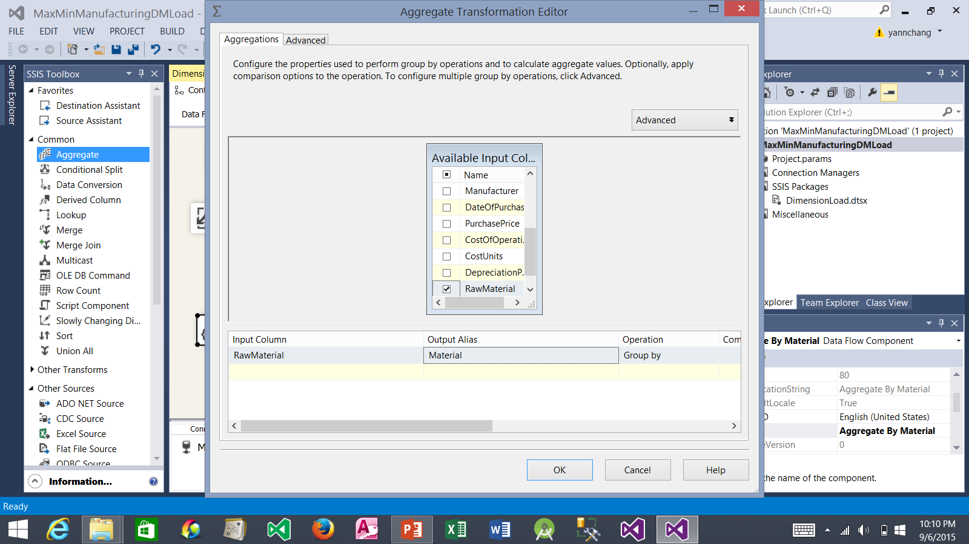
Creating the Load Material-Machine Type-Machine Data Flow (continued)
1. Scroll down to show RawMaterial column and checkmark it. This groups the data by the RawMaterial column to give us a unique list of raw materials
2. Change RawMaterial to Material
3. Click the OK button.

Slide 46
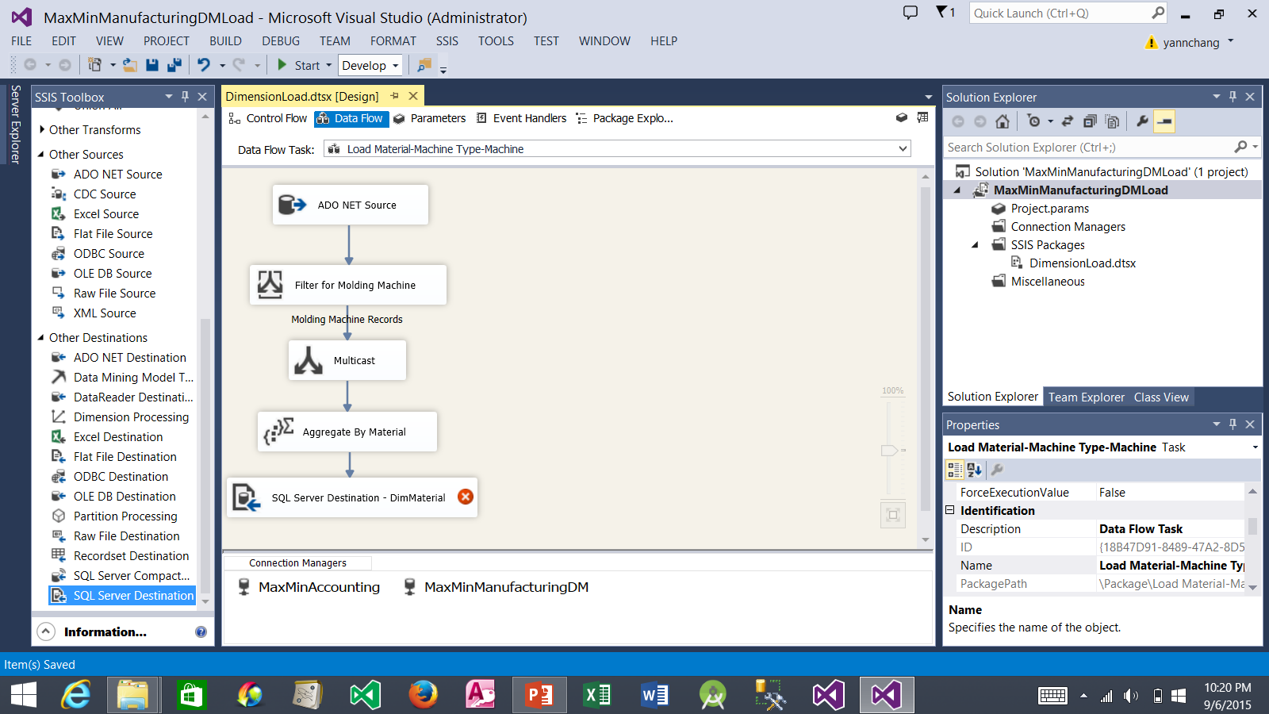
Creating the Load Material-Machine Type-Machine Data Flow (continued)
3. Double click the SQL Server Destination to configure it.
1. Drag the SQL Server Destination.
2. Drop it here. Rename it as shown. Drag the blue arrow from Aggregate By Material and drop the arrow on the SQL Server Destination.

Slide 47
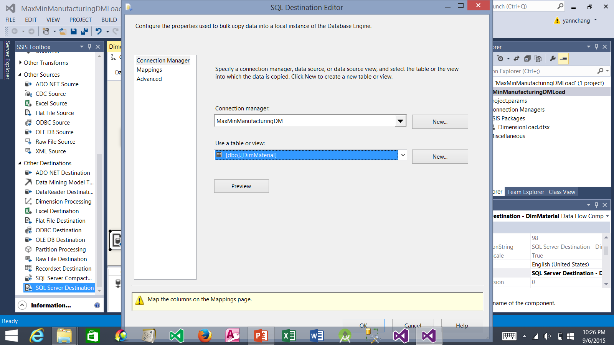
Creating the Load Material-Machine Type-Machine Data Flow (continued)
1. Select MaxMinManufacturingDM
2. Select dbo.DimMaterial.
3. Click Mappings.

Slide 48
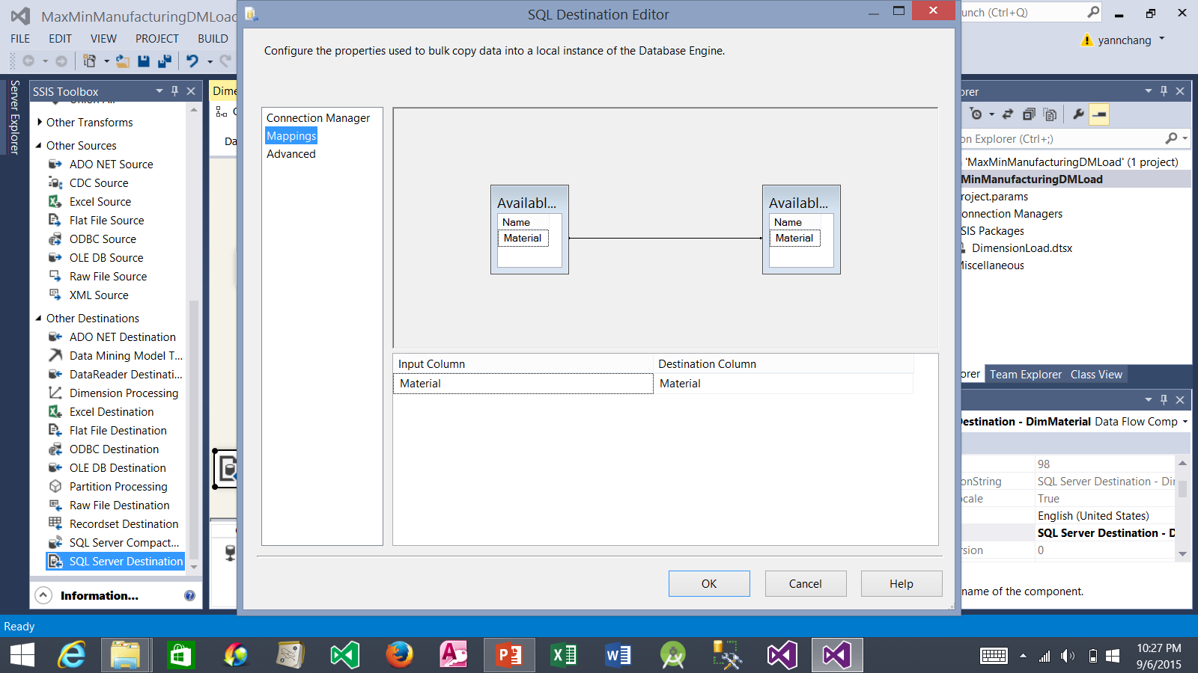
Creating the Load Material-Machine Type-Machine Data Flow (continued)
1. Source (input) column is automatically mapped to destination column because the column names are the same.
2. Click the OK button.

Slide 49

Creating the Load Material-Machine Type-Machine Data Flow (continued)
3. Double click the Aggregate By Machine Type to configure it.
1. Drag the Aggregate.
2. Drop it here. Rename it as shown. Drag the second blue arrow from Multicast and drop the arrow on the Aggregate By Machine Type.

Slide 50
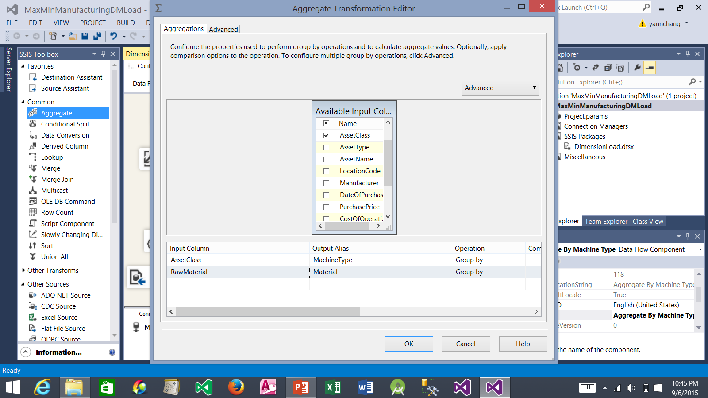
Creating the Load Material-Machine Type-Machine Data Flow (continued)
1. Checkmark both AssetClass and RawMaterial columns. This action groups the data by the AssetClass and RawMaterial columns to give us a unique list of machine types and their raw materials
2. Change AssetClass to MachineType and RawMaterial to Material.
3. Click the OK button.

Slide 51
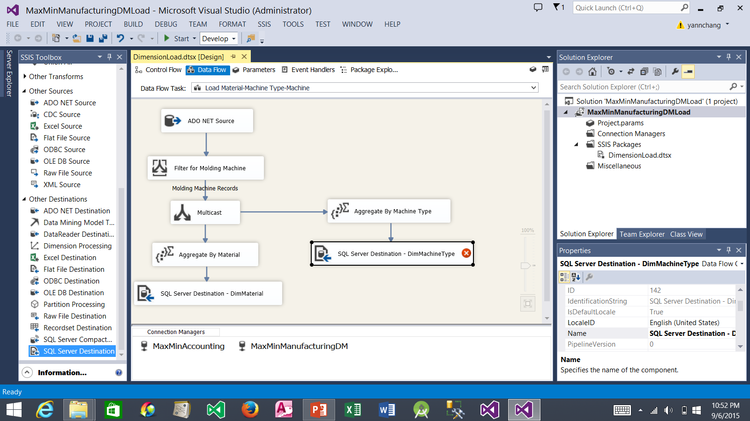
Creating the Load Material-Machine Type-Machine Data Flow (continued)
3. Double click the SQL Server Destination to configure it.
1. Drag the SQL Server Destination.
2. Drop it here. Rename it as shown. Drag the blue arrow from Aggregate By Machine Type and drop the arrow on the SQL Server Destination.

Slide 52

Creating the Load Material-Machine Type-Machine Data Flow (continued)
1. Select MaxMinManufacturingDM
2. Select dbo.DimMachineType.
3. Click Mappings.

Slide 53
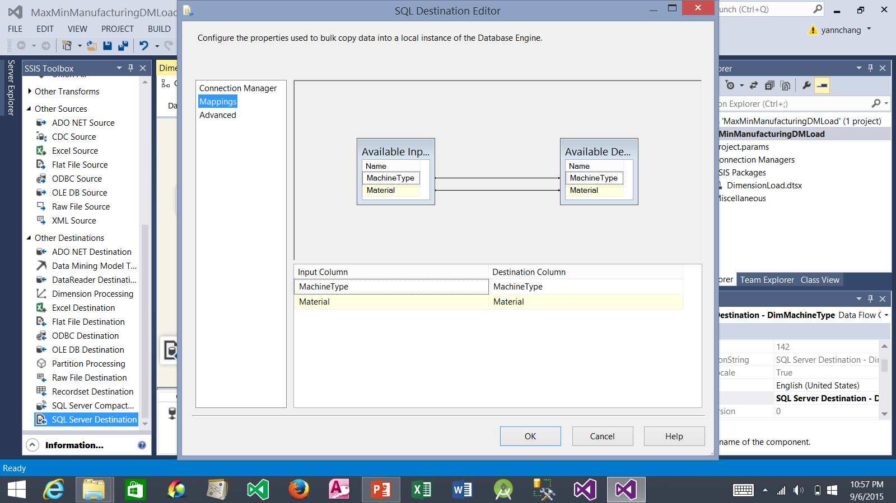
Creating the Load Material-Machine Type-Machine Data Flow (continued)
1. Source (input) columns are automatically mapped to destination columns because the column names are the same.
2. Click the OK button.

Slide 54

Creating the Load Material-Machine Type-Machine Data Flow (continued)
2. Drop it here. Rename it as shown. Drag the third blue arrow from the Multicast and drop the arrow on the SQL Server Destination.
3. Double click the SQL Server Destination to configure it.
1. Drag the SQL Server Destination.

Slide 55

Creating the Load Material-Machine Type-Machine Data Flow (continued)
1. Select MaxMinManufacturingDM
2. Select dbo.DimMachine.
3. Click Mappings.

Slide 56
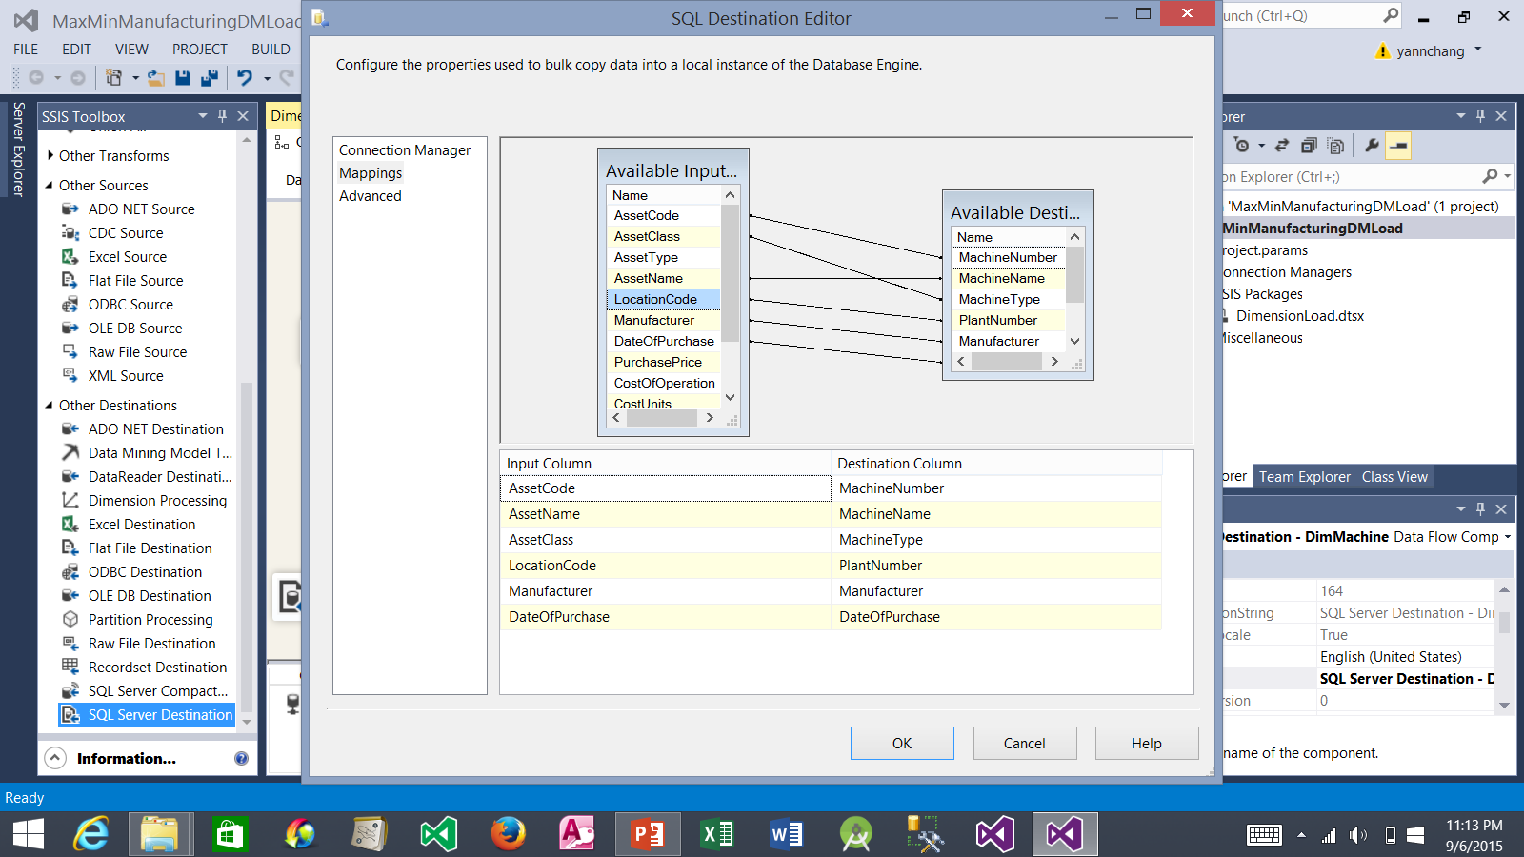
Creating the Load Material-Machine Type-Machine Data Flow (continued)
1. Drag the following columns and drop them on their corresponding columns: AssetCode on MachineNumber, AssetClass on MachineType, AssetName on MachineName, and LocationCode on PlantNumber.
2. Click the OK button.

Slide 57
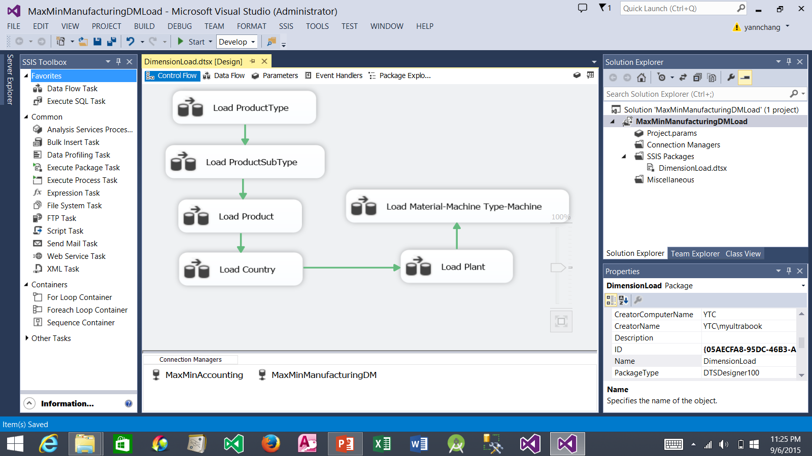
Save and Execute the Integration Service Package
3. Click Start to execute the completed package.
2. Click the Control Flow tab.
1. Click the Save All button

Slide 58
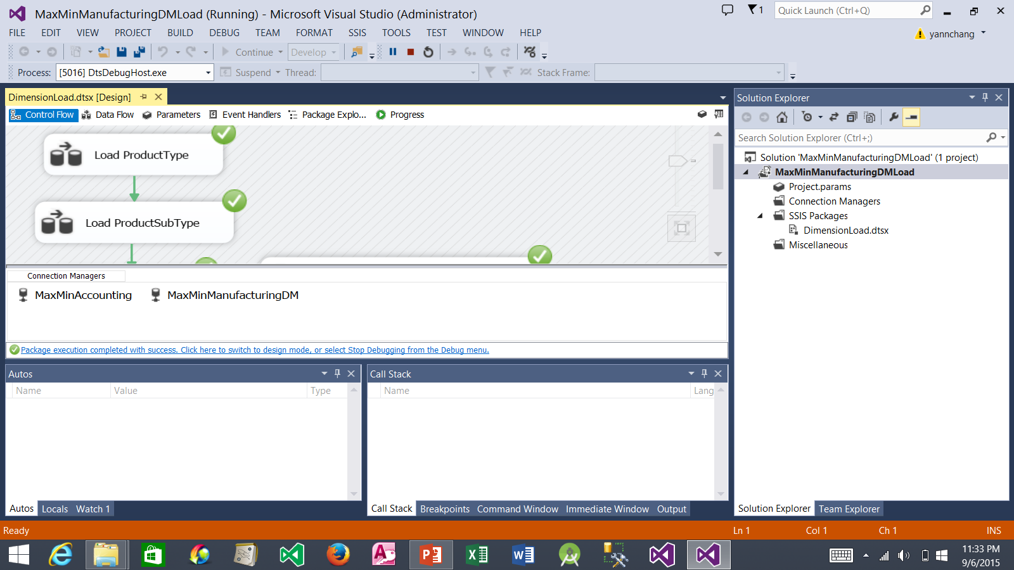
Successful Package Execution
1. Package execution completed with success. The MaxMinManufacturingDM Dimension tables are now populated with some data from MaxMinAccounting database. Next tutorial: populating the Facts tables in the MaxMinManufacturingDM

